Slide 1
Forecast of Unemployment Rate in Women A SARIMA Model Approach
Business and Econ Forecasting 5337
Graduate Group Presentation
12/06/2022

Slide 2
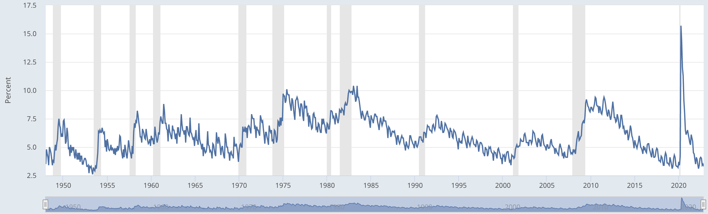
Introduction
Unemployment has been always a concern causing a nation to lose its economic and financial growth.
This is the original graph of our dataset showing estimates of women worker employment.
The ratio of weighted women employees to the weighted all employees in the sample is assumed to equal the same ratio in the universe.
The series comes from the 'Current Population Survey (Household Survey)'

Slide 3
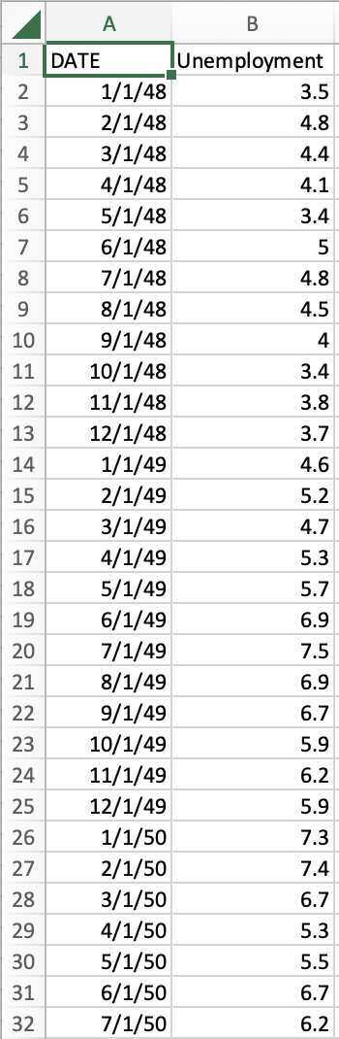
Original Data
The original unemployment data starts on January 1,1948 and lasts until October 1, 2022 (monthly and seasonally adjusted, units is percentage)
There are dips and increases in the unemployment rate are a result of numerous events that have an impact on employment.
Source: FRED Economic Datasets https://fred.stlouisfed.org/series/LNS14000002

Slide 4
What causes dips and rise?
A change in the labor force's size may have an impact on the unemployment rate.
Change in the number of job seekers is another obvious cause.
The Bureau of Labor Statistics defines unemployed people as those who are actively looking for jobs in the market, those who are currently jobless, and those temporarily laid off from their jobs.
The widespread covid-19 virus, which affected every sector and ultimately disrupted the economy by causing layoffs and a spike in the unemployment rate, led the largest increase in our data to occur in April 2020.

Slide 5
Why forecast this?
Human welfare depends on having the freedom to labor as one pleases, within circumstances of dignity, safety, and justice. Making sure that women can exercise this privilege is a worthwhile goal in and of itself.
Women around the world have a much harder time finding employment than men do. When women do find employment, it is typically in low-paying, risky positions, and there are few signs of improvement in the near term.
Women currently make up just under 47% of the worldwide labor force, 72% of it is male.
Males are more likely to work in own-account employment than females, who are more likely to assist in families or family enterprises. Risky employment is common for both men and women, but women tend to be overrepresented in particular types of vulnerable occupations.

Slide 6
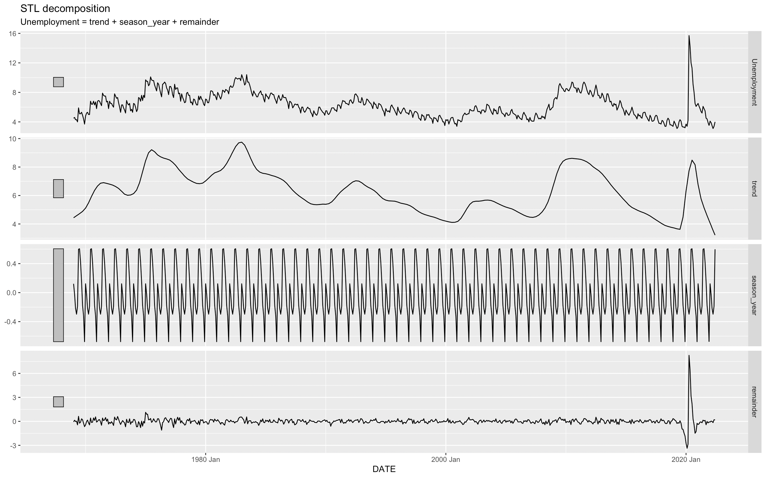
STL Decomposition
Seasonality and Trend
From STL decomposition, we can observe that there is no proper trend in our dataset as there are many peaks which rise or fall.

Slide 7
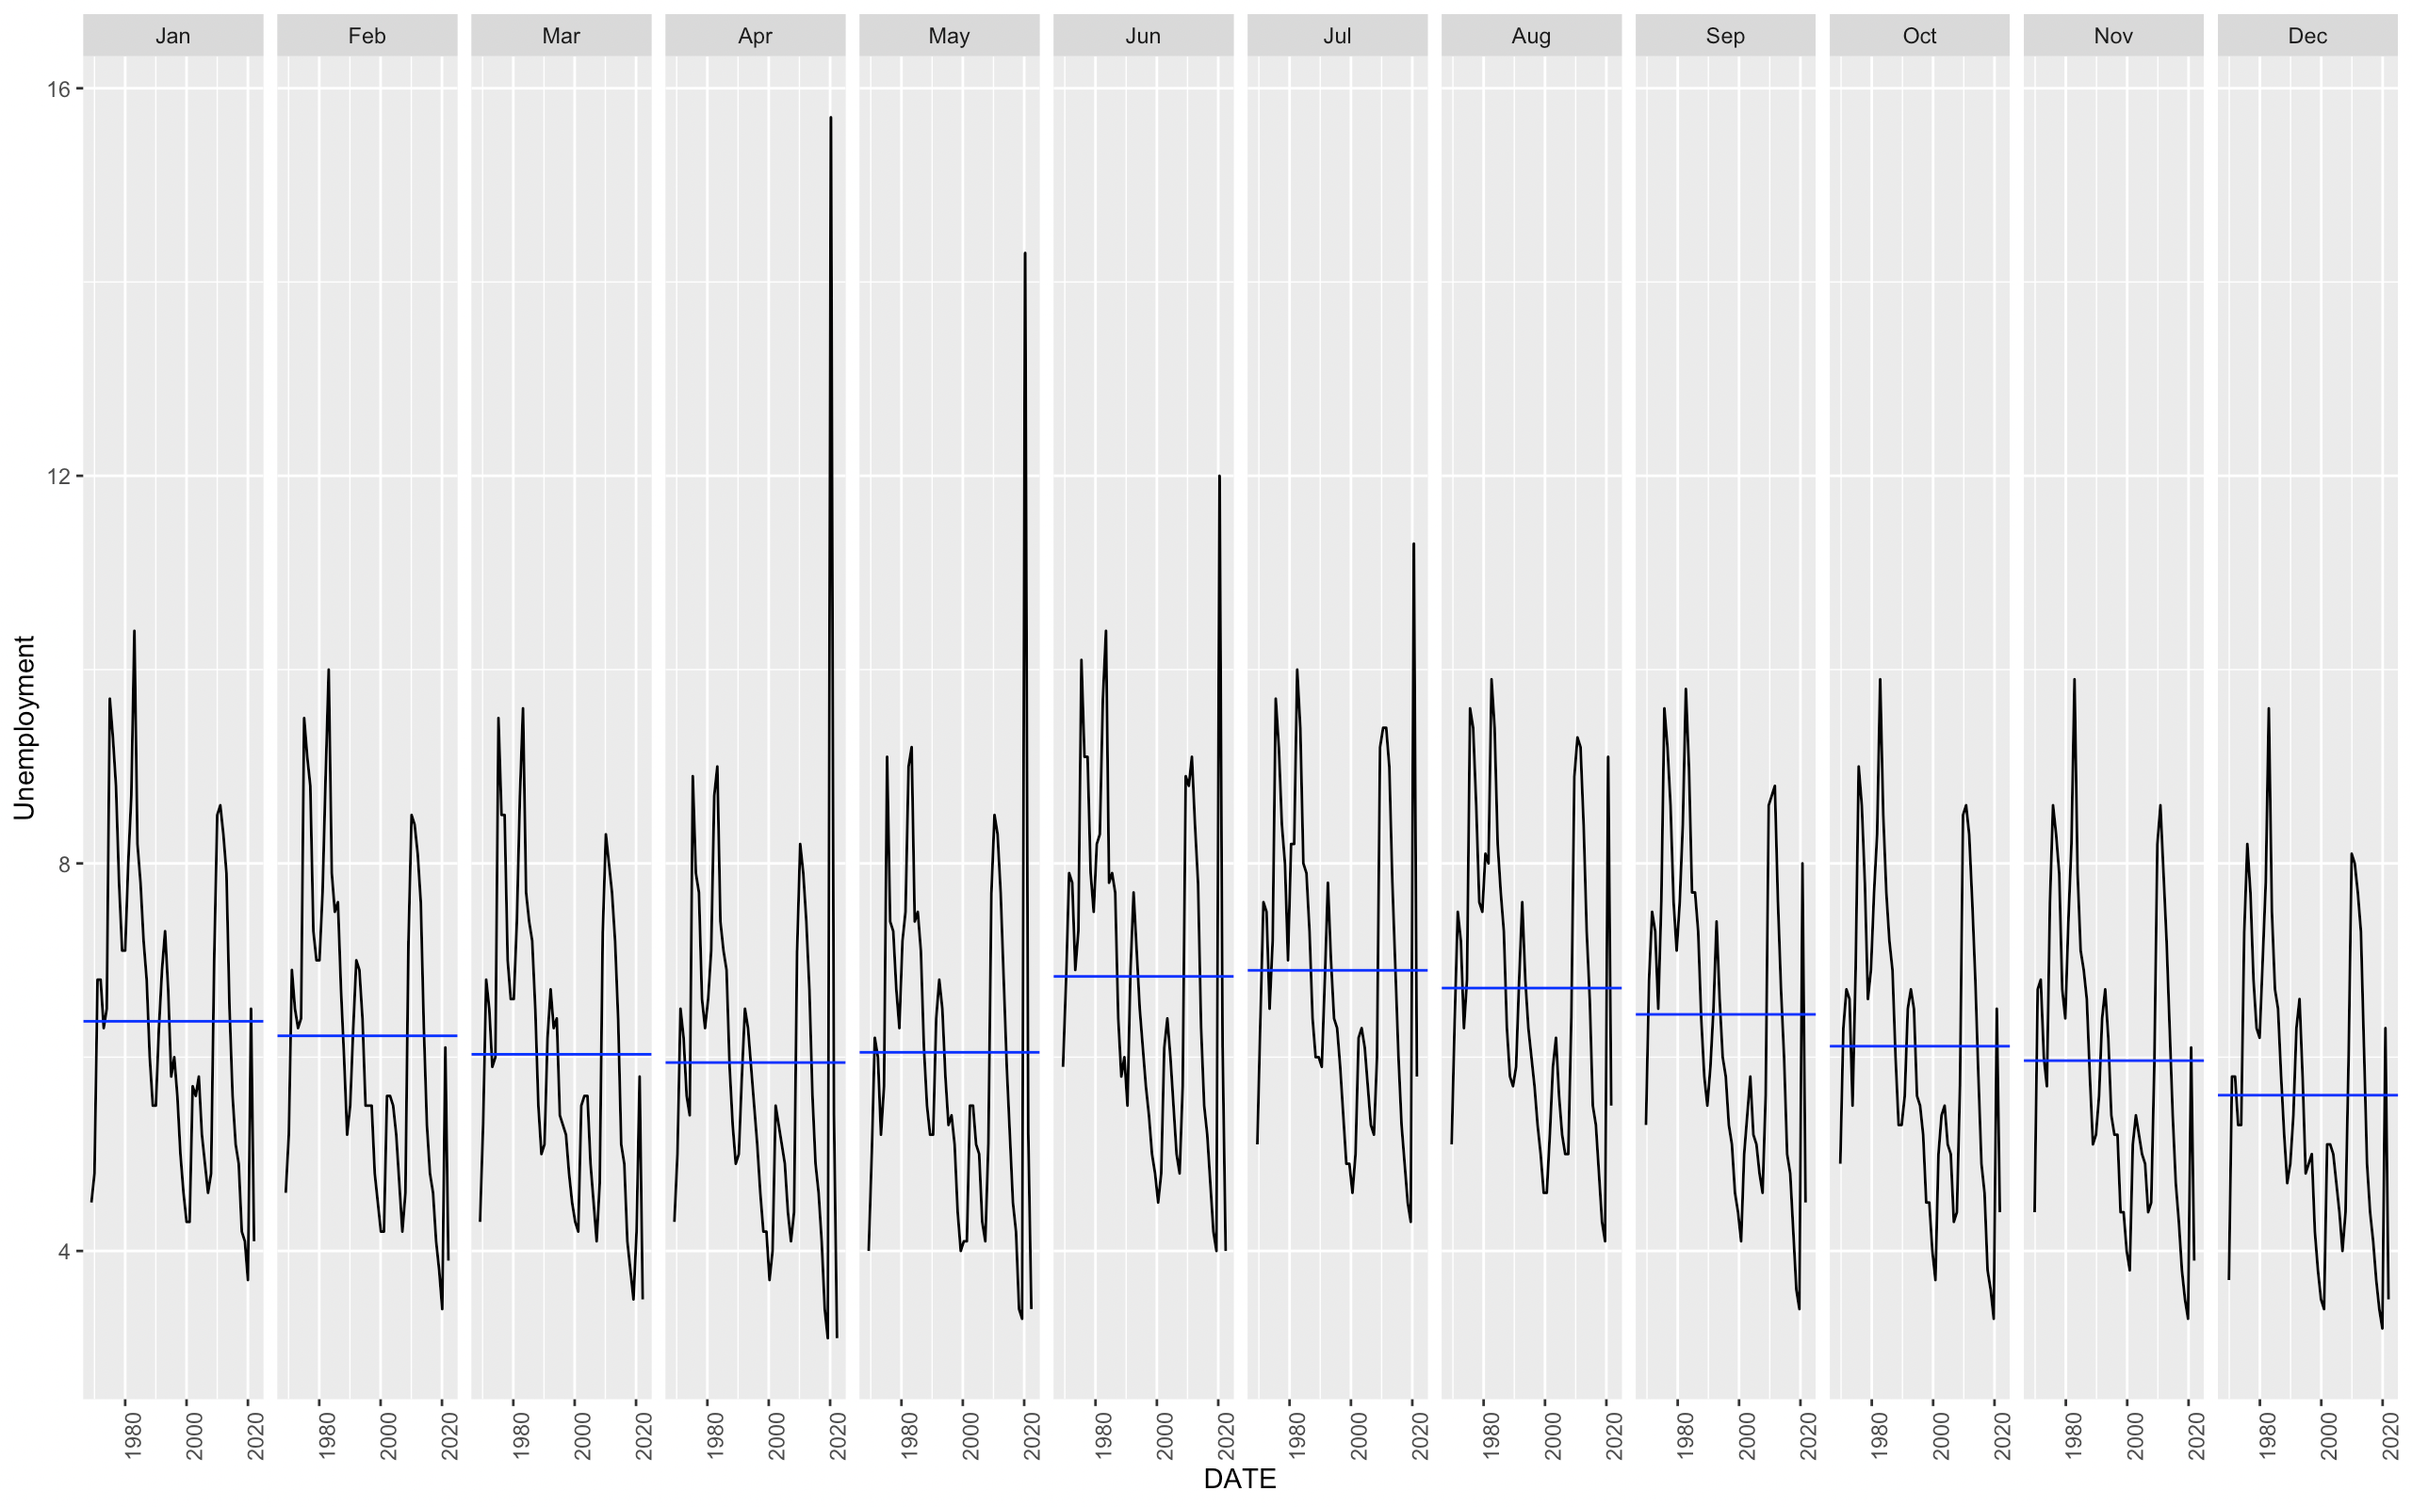
STL Decomposition cont.
Seasonality and Trend
From the gg subseries plot, we clearly see that there is seasonality in our data.
The month of May and June has highest rate of unemployment, while December has lowest.

Slide 8
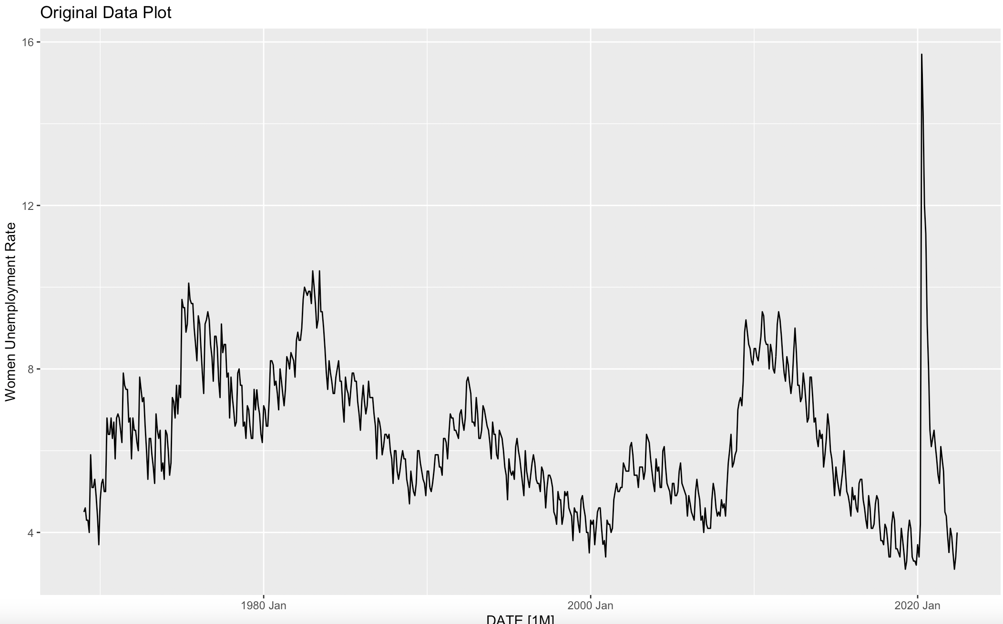
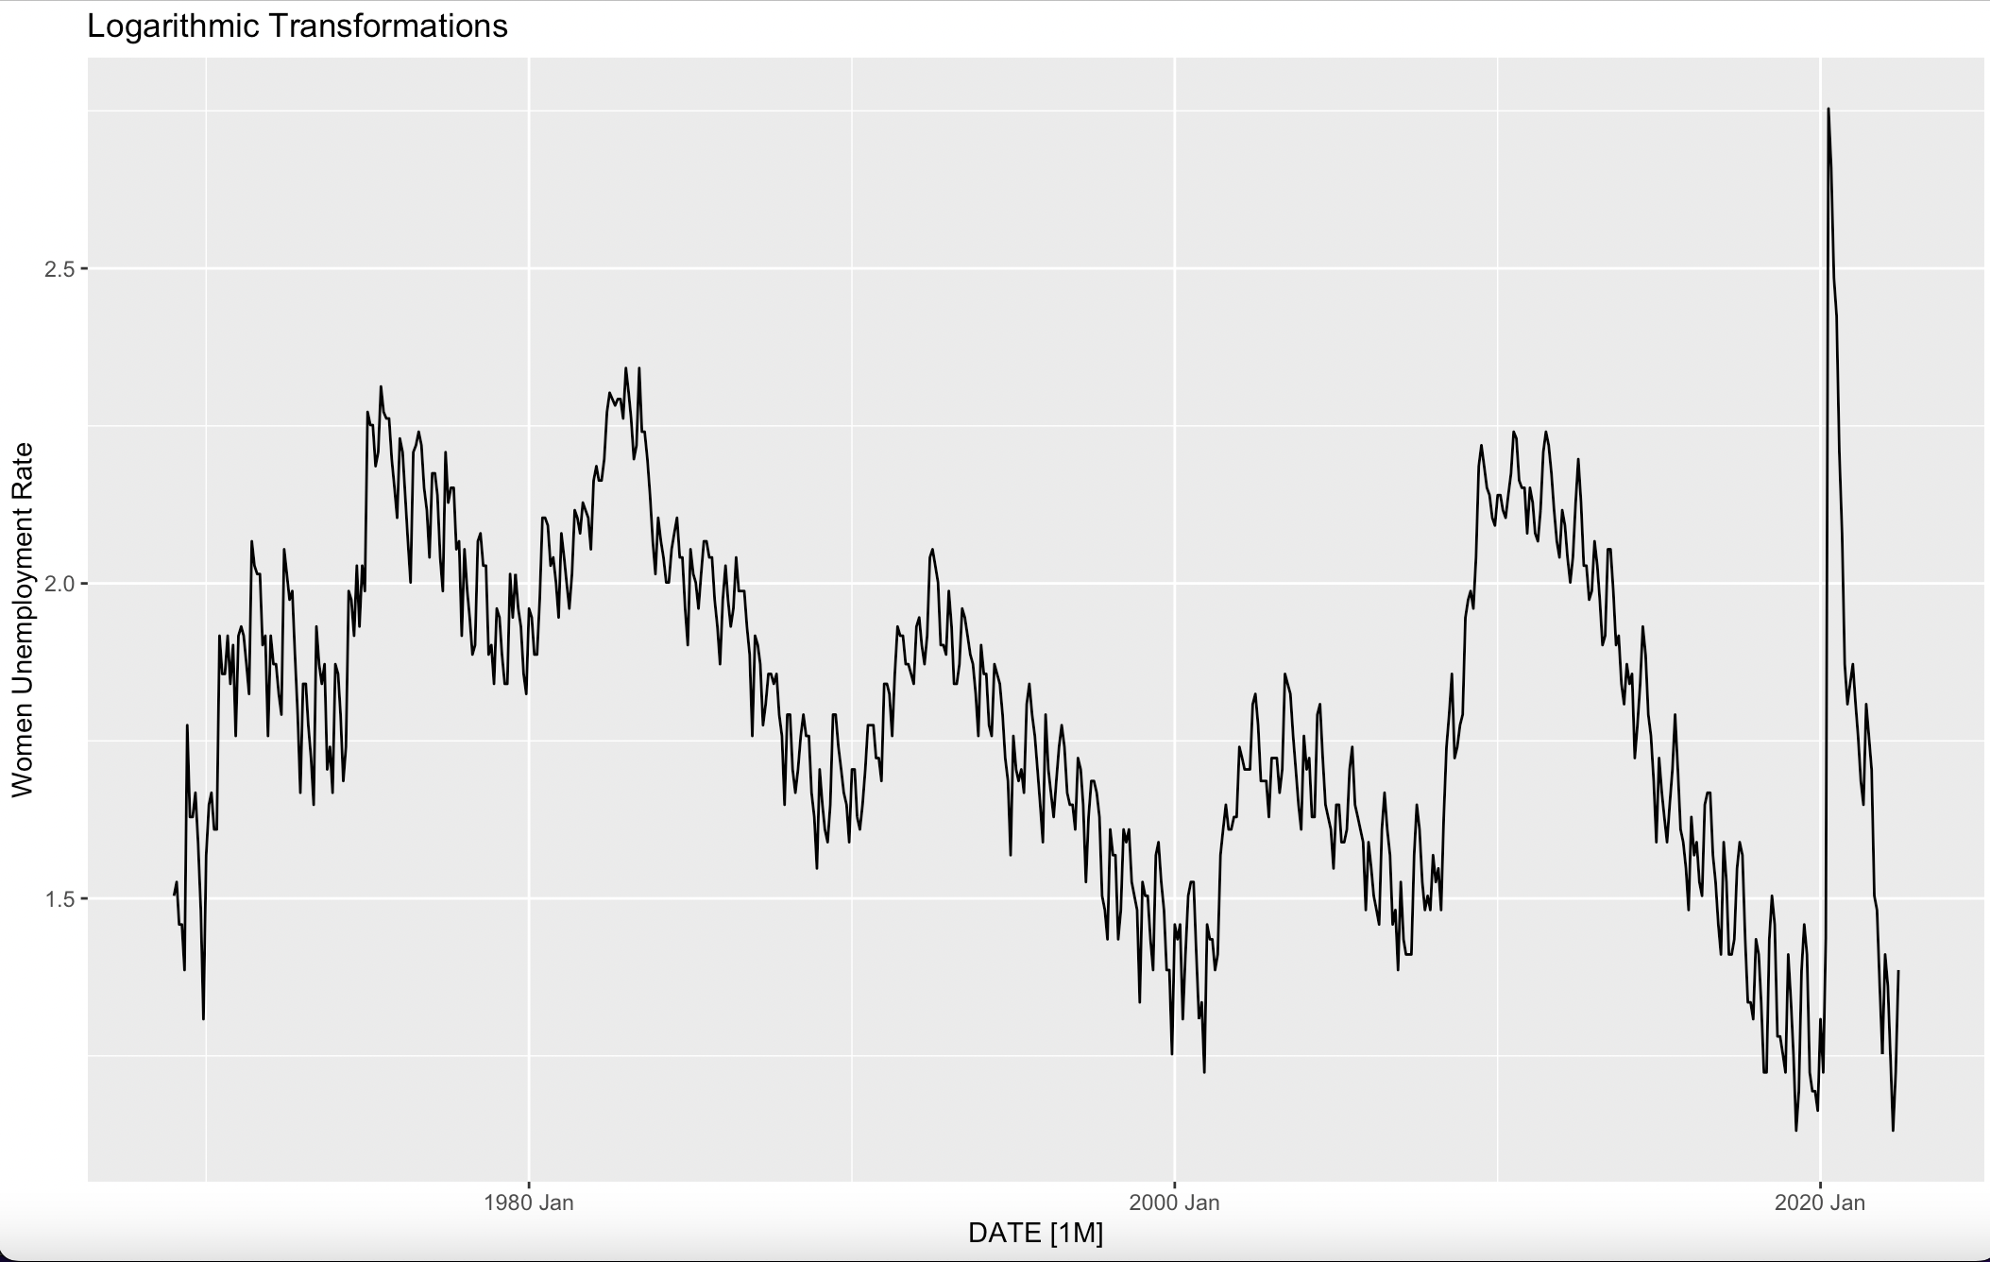
Original Data Plot and
Log Transformation
Holdout period is being utilized for this plot and log transformation is applied.
Next slide shows box-cox transformation.

Slide 9
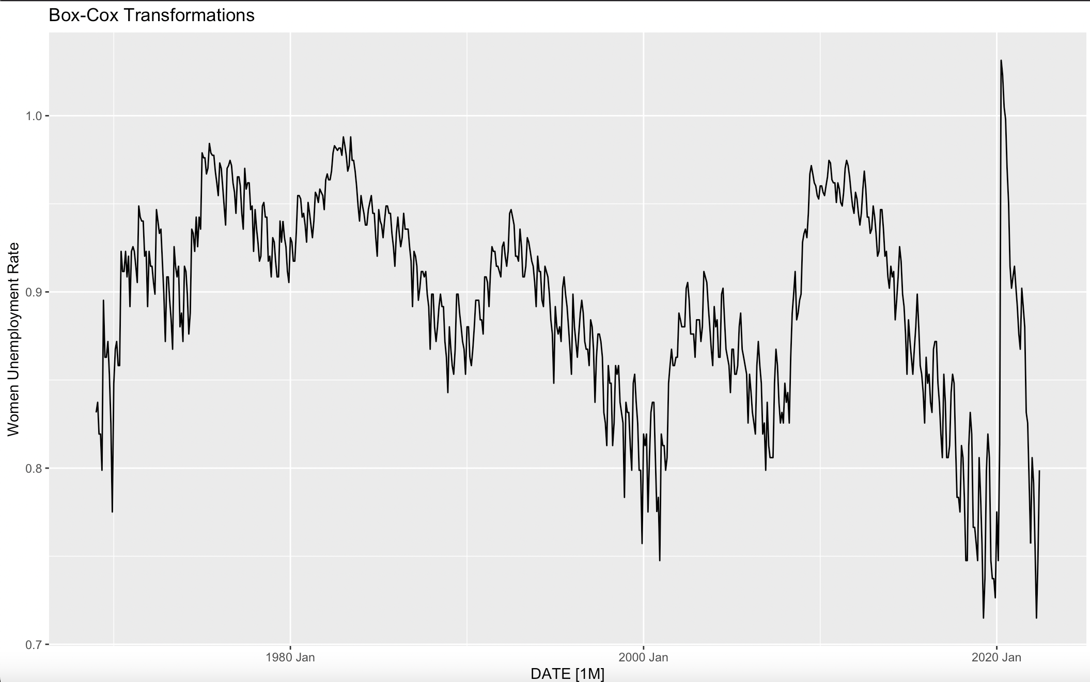
Box-Cox Transformation
A statistical method called the Box-Cox transformation alters the target variable so that the data closely matches a normal distribution. We presume that the mistakes are regularly distributed in many statistical methods. We can create confidence intervals and do hypothesis tests thanks to this supposition. We can possibly normalize errors by altering the target variable, if they are not already normal.
We are not taking any transformations because both box-cox and log doesn't have much impact on the volatility and we do not anticipate any non-linear growth in the future women unemployment rates.

Slide 10
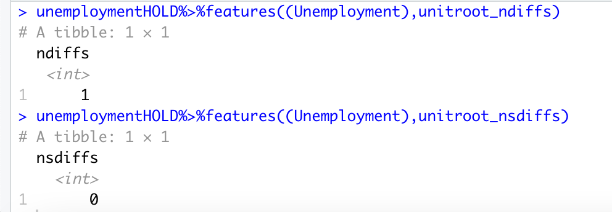
Stationarity Check
The uniroot test establishes stationarity in a series and shows whether or not differencing is required. After utilizing the features function, we can see that the uniroot ndiffs value is 1, indicating that non-seasonal differencing is required. As a result, we must set d to 1.
Since there is no requirement for seasonal differencing, we can set D=0 because the uniroot nsdiffs value obtained is 0.

Slide 11
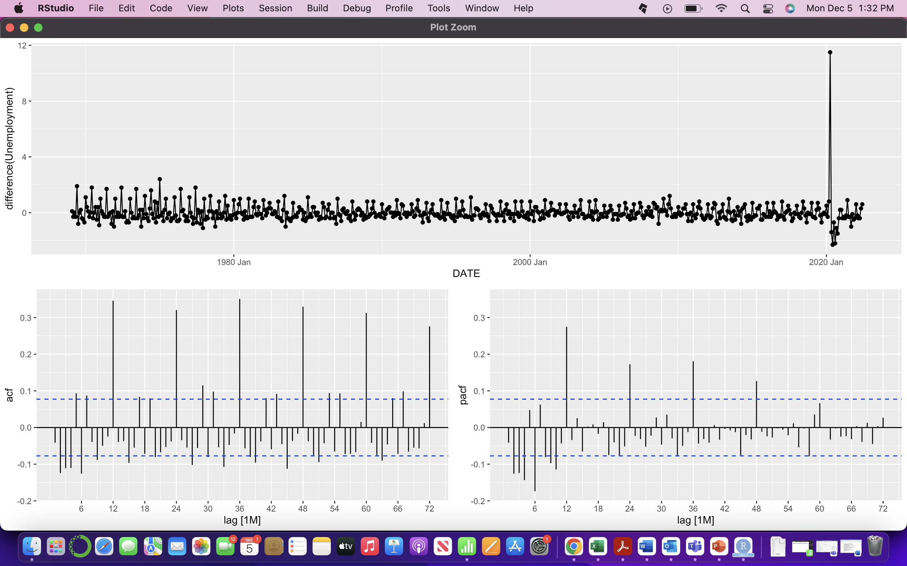
Stationarity Results Post Differencing
This is our plot after applying the non-seasonal differencing .
ACF and PACF plots will give us the initial model.

Slide 12
ACF and PACF Interpretation
From ACF Plot, we see that every 12th lag is statistically significant. We also observe that many coefficients at non-seasonal lags (lags 2 to 7,lags 15,17 etc) are statistically significant, with a grouping of coefficients that are both positive and negative.
From PACF Plot, a similar pattern is observed relative to ACF Plot, where initial sample PACF coefficients tend to be even larger.
At seasonal lags, only the coefficients at lag 12 to 48 are statistically significant. A variety of models seem possible.

Slide 13
Model Guess - ACF and PACF Interpretation
We are considering P=4 and Q=0 as the true PACF at every 12th lag after lag 48 should be zero.
At non-seasonal lags, a stronger case could be made for our autoregressive component, where the true ACF would be non-zero at all lags.
A reasonably large number of sample PACF coefficients seemed statistically important. We are considering p=10 and q=0,as we can see non-seasonal lags at lag 10 is statistically significant.
6 model chosen

Slide 14
Models – AIC & BIC
pdq(10,1,0)+PDQ(4,0,0)
AIC=1113.19 BIC=1180.13
pdq(6,1,1)+PDQ(2,0,1)
AIC=1108.013 BIC=1157.107
pdq(6,1,2)+PDQ(1,0,1)
AIC=1109.370 BIC=1158.463
pdq(4,1,1)+PDQ(2,0,1)
AIC=1109.361 BIC=1149.528
pdq(2,1,2)+PDQ(1,0,1)
AIC=1104.497 BIC=1135.738
pdq(2,1,1)+PDQ(2,0,1)
AIC=1106.394 BIC=1137.636

Slide 15
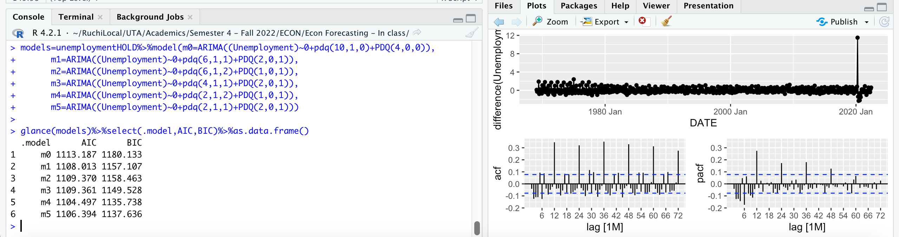
Model Comparison
m0=pdq(10,1,0)+PDQ(4,0,0)
AIC=1113.19 BIC=1180.13
m1=pdq(6,1,1)+PDQ(2,0,1)
AIC=1108.013 BIC=1157.107
m2=pdq(6,1,2)+PDQ(1,0,1)
AIC=1109.370 BIC=1158.463
m3=pdq(4,1,1)+PDQ(2,0,1)
AIC=1109.361 BIC=1149.528
m4=pdq(2,1,2)+PDQ(1,0,1)
AIC=1104.497 BIC=1135.738
m5=pdq(2,1,1)+PDQ(2,0,1)
AIC=1106.394 BIC=1137.636

Slide 16
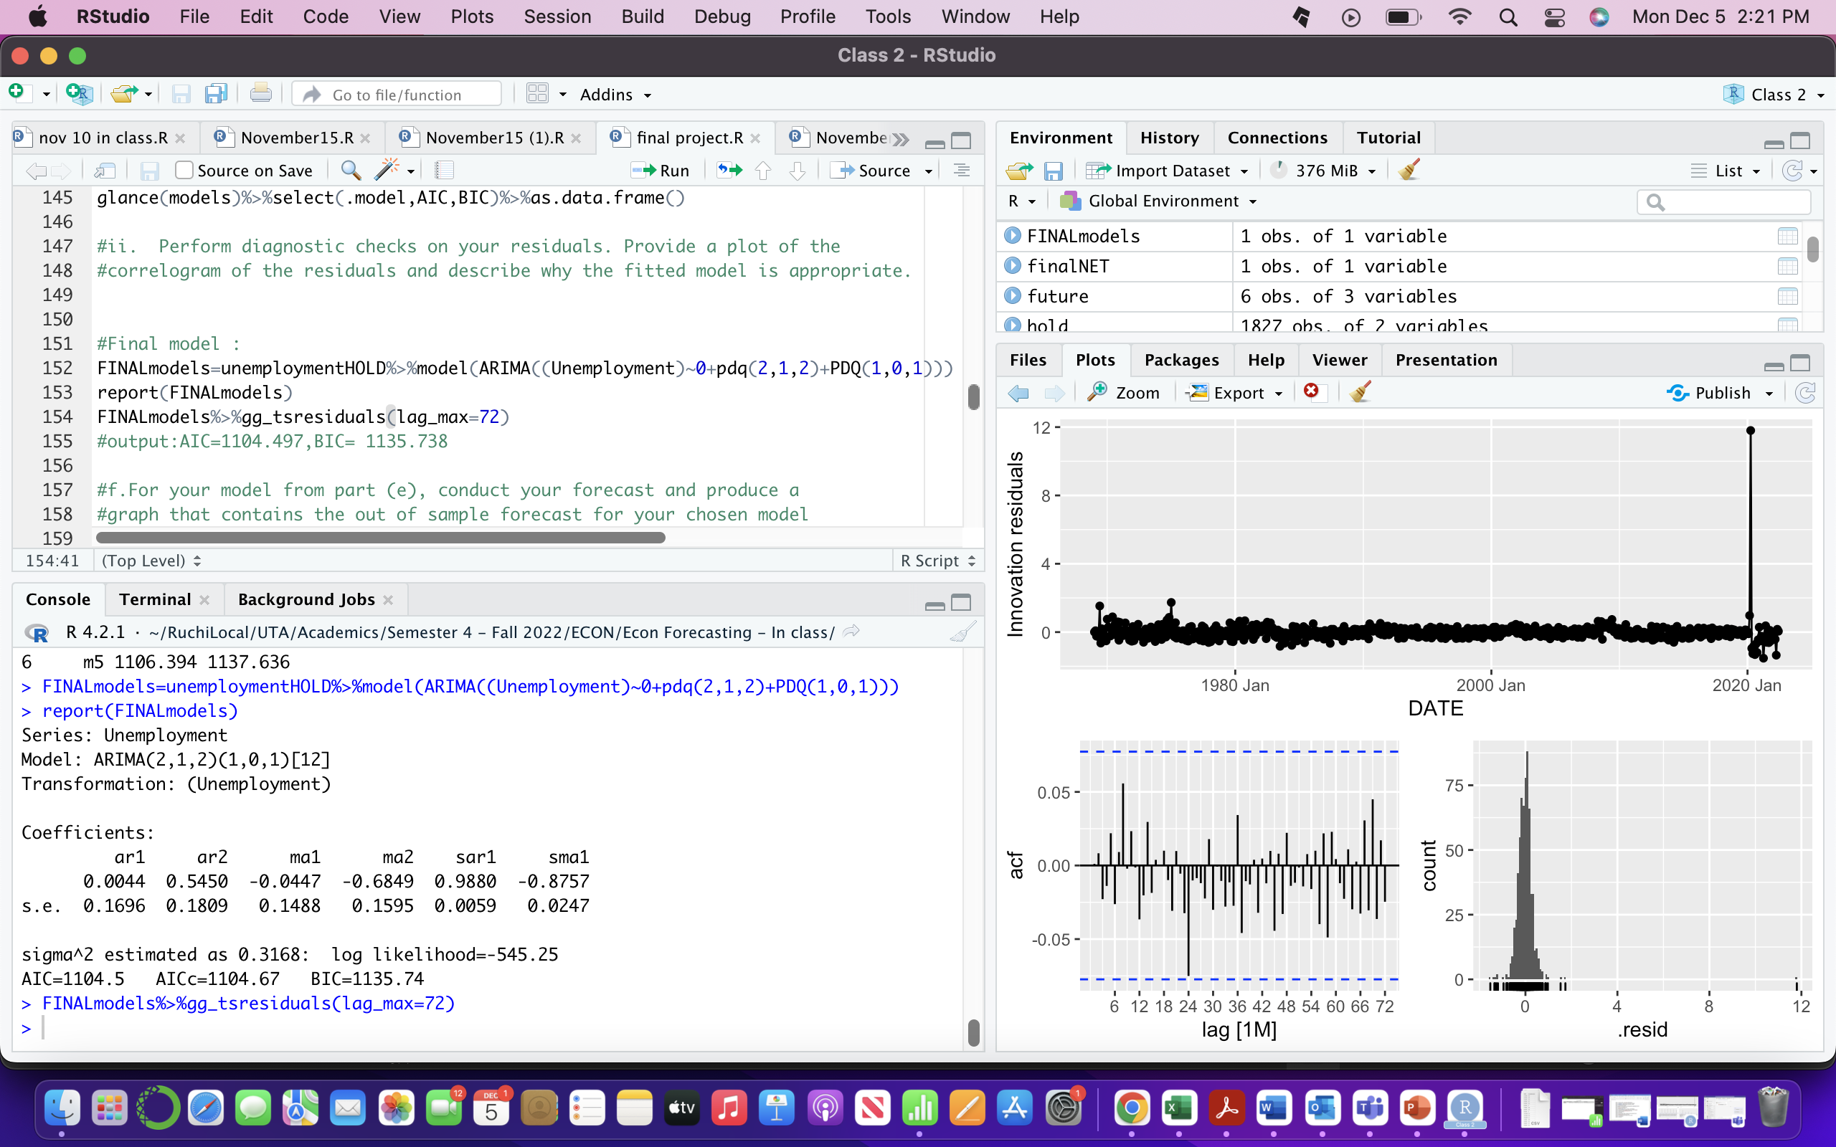
Model Selection
Final model :
Lowest AIC and BIC values was obtained for
m4 = pdq(2,1,2)+PDQ(1,0,1)
AIC=1104.497 BIC=1135.738

Slide 17
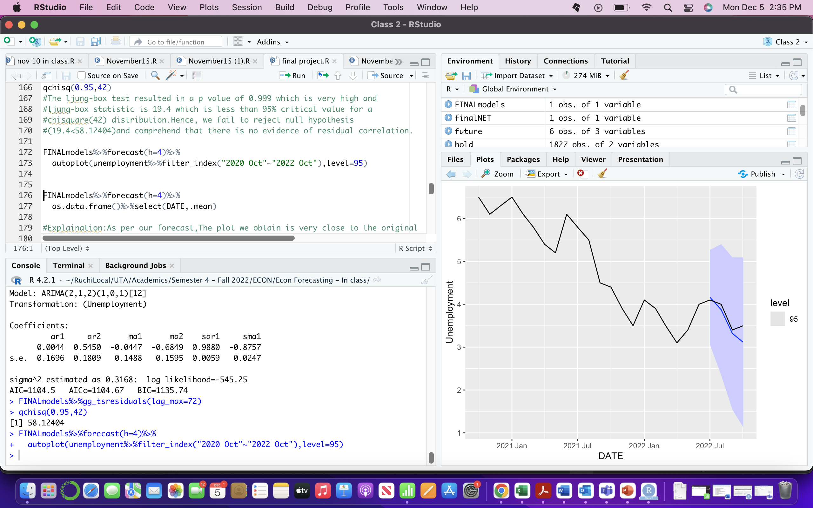
Ljung-box
The ljung-box test resulted in a p value of 0.999 which is very high and ljung-box statistic is 19.4 which is less than 95% critical value for a chisquare (42) distribution. Hence, we fail to reject null hypothesis (19.4<58.12404) and comprehend that there is no evidence of residual correlation.

Slide 18
Forecast
As per our forecast the plot we obtained is very close to the original data points and therefore, we can conclude that the model we chose is accurate enough.
How will this help in future?

Slide 19
Forecast using Original Data
As per our forecast the plot we o

Slide 20
ETS Method
As per our forecast the plot we o

Slide 21
Many companies today follow diversity, equity and inclusion and thus if an industry increases the proportion of women it employs, the unemployment rate of women will decrease relatively.
There always has been a gender difference working in an organization. The industries can respond to changes in labor force participation by altering the distribution of their employment equally between sexes.
Conclusion

Slide 22
References
https://fred.stlouisfed.org/series/LNS14000002
https://stats.bls.gov/opub/mlr/1984/11/art2full.pdf
https://www.ilo.org/infostories/en-GB/Stories/Employment/barriers-women#intro

